Slide 1

RESULT5035

Slide 2
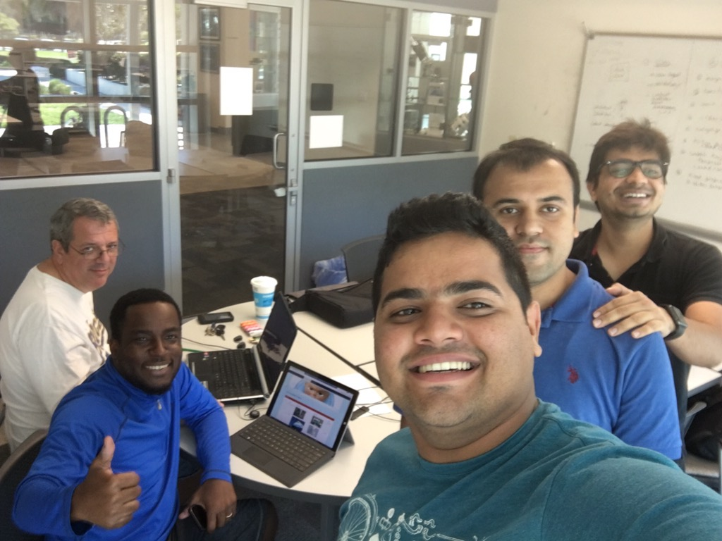
Group Members
Christopher Foley (Product owner)
Yom Chouloute (Scrum master)
Divyang Purpohit (Dev)
Retesh Velapakam(Dev)
Ashish Arora(Dev)

Slide 3
Product Overview
Universities and schools are not small places. Take FAU as an example, this university covers approximately 850 acres. To give you a little perspective, the dimension of a football field, including the end zones covers approximately 1.32 acres. Hypothetically speaking, you can fit 644 football fields inside FAU.
Administrators and facilities employees at these large institutions usually do their best to provide students with a clean, hazard free and a safe environment. They have employees assigned to maintain each region on campus, they use video cameras and the help of the police department to survey all areas.
Although Administrators and maintenance staffs do their best, there is always room for improvement, since it is quasi impossible to monitor every corner on campus.
Introducing “EduSnap” a responsive website created by a group of students at FAU that can make it very easy for anyone on campus report issues that require immediate attention.
We are hoping to add to a link to our responsive site in the University mobile App. Doing so will make it very easy for everyone to access the application.

Slide 4
Requirements & main functionalities
Easy to use (Ability to create a ticket in less than 30 seconds)
Ad Hoc Ticket Submission for faster ticket creation
User Registration if our users want to track their own tickets
Different view for each user type
Email Functionality
Point system and prize for the person who reports the most completed tickets.

Slide 5
User Stories - Use Case
Regular User
Dispatcher
Local Staff
Third-party Staff
Manager

Slide 6
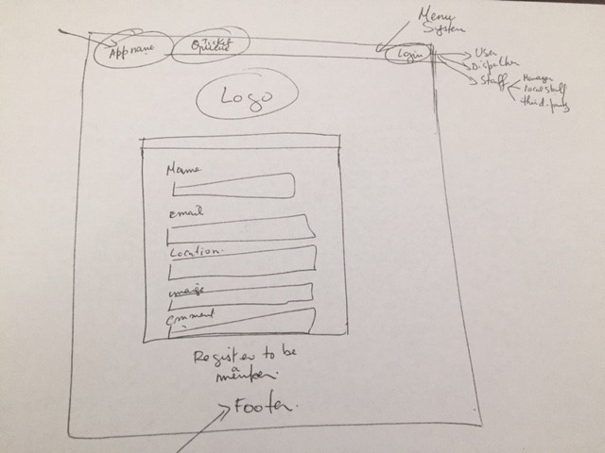
Product Design
We designed our application using plain old papers and pens.
We played with balsamiq and we decided to go with pens and papers because of time constraints.

Slide 7
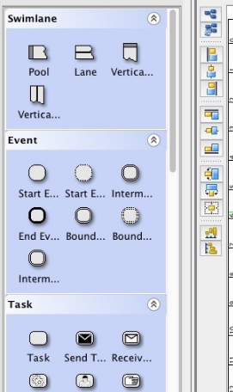
BPMN Model
Our BMPN Model in Complete.
We are submitting it on Dec 2, 2016

Slide 8
Trello & Scrum
We used Trello as our Scrum tool
https://trello.com/b/NUxI9Com/result5035

Slide 9
Knowledge Gained
Here are a few things that we learned in this class:
Software modeling
Webratio
Cameo Tools
Scrum (Product owner, scrum master….)
...

Slide 10
Changes (Since the last Demo)
Validation (We added validation to all our data entry forms)
We added a user registration to help our users keep track of their tickets’ status.
We have added email functionality
Image display resize
Prize system (In progress)

Slide 11

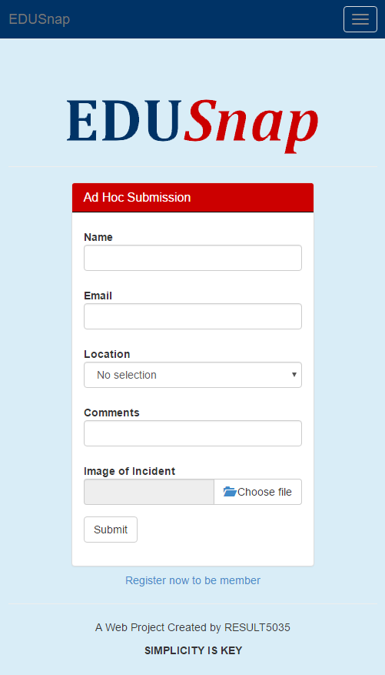
Demo

Slide 12
Functionalities
User Registration: -> Done
Validation -> Done
Email Functionality -> Done
Image display resize -> Done
User management -> Not Done
Search Ticket -> Done
Find prize winner for Date Range -> Not Done
Prizes -> in progress

Slide 13
Next Steps
We would like to add GPS functionalities to the system so we can pinpoint the exact location of an issue.
We would like to package the application and deploy it on its own server.
We would like to add user management portal, instead of adding users directly to the database
We would like to promote the application the higher ups.
We would like to encrypt the sensitive information in the database.

Slide 14

Questions
or
Feedback
?

